Slide 1


Security, FinOps & Token Economics for Enterprise Agents
Architecting Hardened Zero-Trust Agent Runtimes, Elastic Token Infrastructure, TCO/ROI Models, and Latency-Cost Optimization

Slide 2
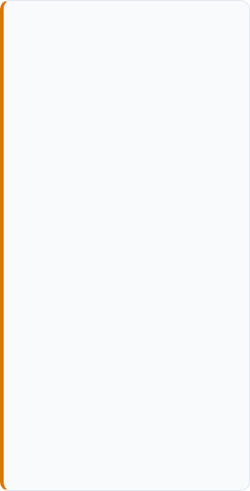
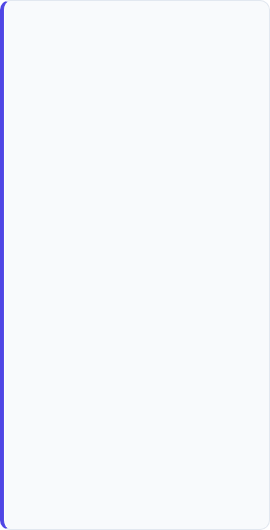
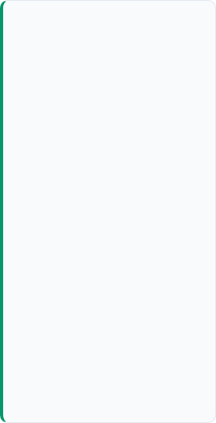
Day 4 Executive Agenda & Objectives
1. Agentic Security
2. Token Economics
3. FinOps & ROI
4. Capstone Prep
OWASP Top 10 for Agentic Applications, Zero-Trust boundaries, sandboxing, and I/O guardrail architecture.
Elastic scaling patterns, multi-tiered semantic caching (Redis), token profiling, and dynamic model routing.
3-Year Enterprise TCO modeling, unit economics per transaction, ROI calculators, and NFR tradeoff matrices.
Integration of security perimeter, token optimization, and cost-latency tradeoff models into team blueprints.

Slide 3

PART 1 • SECURITY ARCHITECTURE
Security in Agentic Systems & Zero-Trust Tooling
Mitigating indirect prompt injections, state poisoning, unauthorized tool escalation, and execution threats

Slide 4
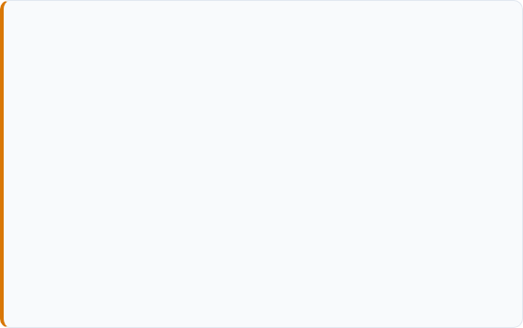
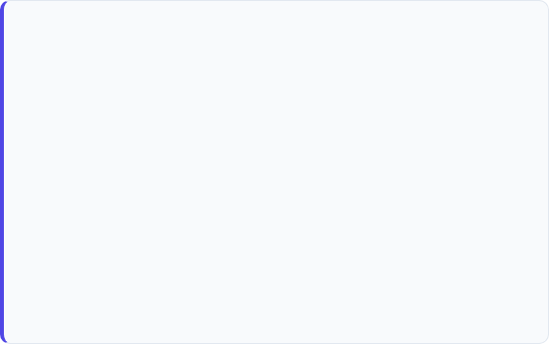
OWASP Top 10 for Agentic Applications
Critical Agent Attack Vectors
Architectural Vulnerabilities
ASI01: Agent Goal Hijack: Attacker alters agent system directives via untrusted input data.
ASI05: Unexpected Code Execution (RCE): Dynamic interpreter output sandbox escapes.
ASI02: Tool Misuse & Exploitation: Agents invoke tools with unintended parameters causing data leaks.
ASI07: Insecure Inter-Agent Comm: Unauthenticated P2P agent message spoofing on internal bus.
ASI03: Identity & Privilege Abuse: Agents inherit excessive ambient permissions or static API tokens.
ASI08: Cascading Failures: Autonomous agent loops propagating unverified errors system-wide.
ASI06: Memory & Context Poisoning: Malicious data planted in RAG vector store infects downstream plans.
ASI10: Rogue Agents: Subverted autonomous agents executing actions outside defined boundaries.

Slide 5

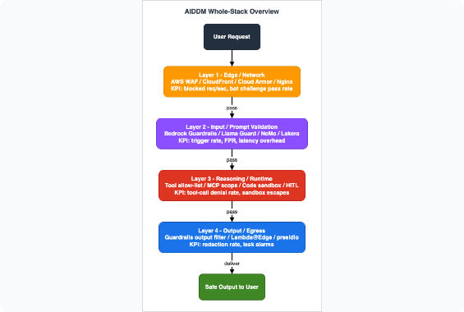
Zero-Trust Agent Sandbox Architecture
Least-Agency Principle: Scoped JIT ephemeral tokens issued per task step rather than long-lived credentials.
Containerized Sandboxing: Code interpreter tools executed inside isolated Docker / gVisor sandboxes without host access.
Agentic Identity Management: Non-human identities with cryptographic signature validation on all tool invocations.
Schema Enforcers: Dynamic JSON-schema validation rejecting untrusted parameters before execution.

Slide 6
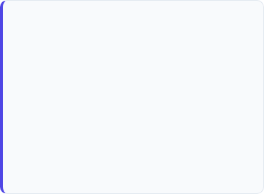
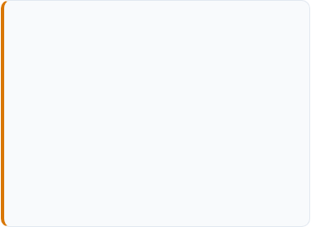
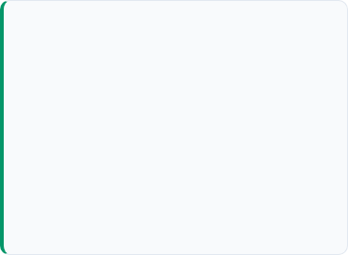
Input/Output Guardrail Pipeline
1. Pre-Execution Guardrails
2. Execution Intent Gates
3. Post-Execution Filters
Intercepts incoming prompt payloads and external retrieval context.
Validates agent decisions before tool triggers occur.
Validates generated responses and data payloads prior to egress.
LlamaGuard & NeMo Guardrails
Goal Drift Monitors
Hallucination & Groundedness Evals
Prompt Injection Classifiers
Deterministic Policy Engines (OPA)
Output Structure (Regex / JSON)
PII & Sensitive Data Anonymizers
Rate & Budget Threshold Locks
Exfiltration & Canary Token Checks

Slide 7

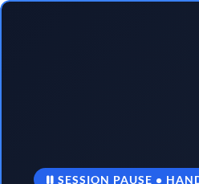
Lab Breakout: Secure Agent Sandbox & Guardrails
In this practical breakout, architect teams will implement input sanitization, dynamic tool scoping, and output guardrail policies.
DURATION30 Minutes
TECH STACKPython / Java / .NET Guardrails SDK
ARTIFACTHardened Agent Execution Repo

Slide 8
PART 2 • ARCHITECTURE & PERFORMANCE
Scaling Patterns, Elastic Compute & Token Economics
Horizontal agent orchestration, state persistence, multi-tiered semantic caching, and dynamic model routing

Slide 9
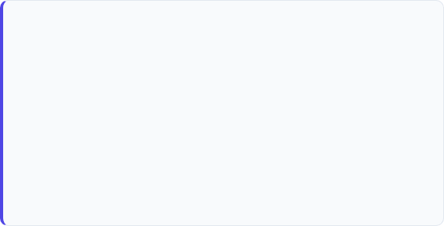
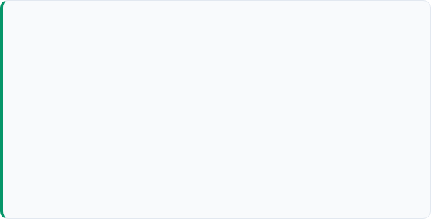
Elastic Agent Compute Scaling Patterns
Stateful vs. Stateless Agent Scaling
Auto-Scaling & Load Allocation Triggers
Stateless Worker Pools: Decouple LLM reasoning workers from state; scale dynamically via K8s HPA based on queue depth.
TTFT & Rate Limit Triggers: Scale instance replicas based on Provider Token-Per-Minute (TPM) saturation.
External State Persistence: Store state graphs in Redis / Cosmos DB to allow any worker to resume agent execution.
Queue Backpressure: Throttle low-priority background workers during enterprise peak hours.
Async Message Broker: Use RabbitMQ / Kafka for non-blocking inter-agent tool delegation.
Multi-Region Provider Pooling: Load balance across AWS Bedrock, Azure OpenAI, and GCP Vertex endpoints.

Slide 10
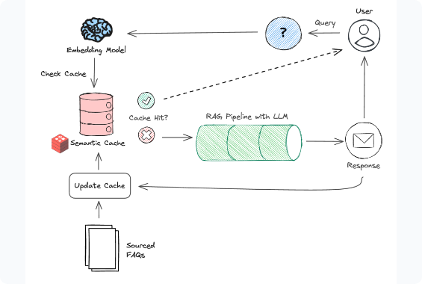
Multi-Tiered Semantic Caching
Exact Match Cache (L1): Key-value hash lookup for deterministic tool queries (0ms LLM cost).
Vector Similarity Cache (L2): Embeds incoming prompts and checks Redis Vector DB for semantic equivalence (>0.92 cosine sim).
Latency Impact: Cuts response latency from 2,500ms down to <40ms for cached queries.
Cost Reduction: Eliminates up to 40% of repetitive prompt token expenditure.

Slide 11
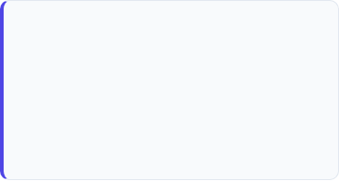
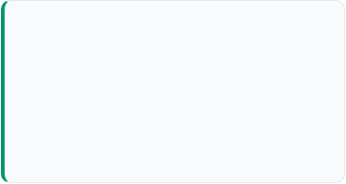
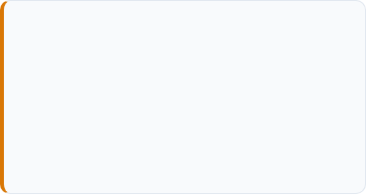
Dynamic Model Routing Framework
Tier 1: High Reasoning
Tier 2: Mid-Range Utility
Tier 3: SLM / Local Task
Models: GPT-4o, Claude 3.5 Sonnet
Models: GPT-4o-mini, Claude 3.5 Haiku
Models: Llama 3.3 8B, Phi-4, Mistral
Use Cases: Primary planner, complex policy synthesis, multi-step orchestration.
Use Cases: Entity extraction, JSON formatting, Worker agents, preliminary intent classification.
Use Cases: Simple tool calling, regex generation, local offline execution in sandboxes.
Cost: ~$2.50 / 1M Tokens
Cost: ~$0.15 / 1M Tokens
Cost: ~$0.02 / 1M Tokens

Slide 12
PART 3 • ENTERPRISE FINOPS & ECONOMICS
TCO / ROI Modeling & NFR Tradeoff Frameworks
Comprehensive cost breakdown, unit economics per transaction, 3-year TCO modeling, and financial justification

Slide 13
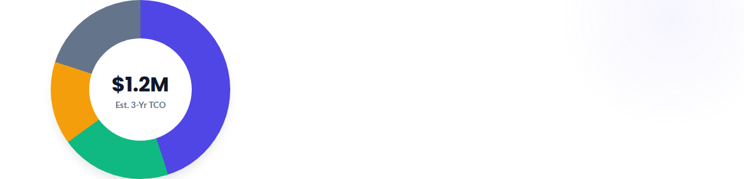
3-Year Enterprise Agent TCO Drivers
LLM Token Consumption (45%): Inference calls across Planner & Worker steps.
Vector DB & Cache Infrastructure (20%): Memory storage, Redis, embedding models.
Governance, Security & Evals (15%): Guardrail API calls, red-teaming, CI/CD/CT.
Operations & Maintenance (20%): Cloud hosting, monitoring, HITL labor cost.

Slide 14
NFR Tradeoff Matrix: Model Tiering
Architecture Tier | Avg Latency (TTFT) | Cost / 1k Claims | Accuracy / Benchmark | Architect Recommendation
Tier 1 Only (GPT-4o) | 1,800 ms | $42.50 | 94.8% | Over-Engineered
Tier 2 Only (GPT-4o-mini) | 420 ms | $2.80 | 81.2% | Accuracy Risk
Dynamic Cascade + Cache | 310 ms | $6.20 | 93.9% | Optimal Architecture
Local SLM + Guardrails | 180 ms | $1.10 | 76.5% | Internal Tasks Only
Key Architectural Takeaway: Implementing dynamic cascades with semantic caching achieves 99% of Tier 1 accuracy while reducing per-transaction unit cost by 85%.

Slide 15
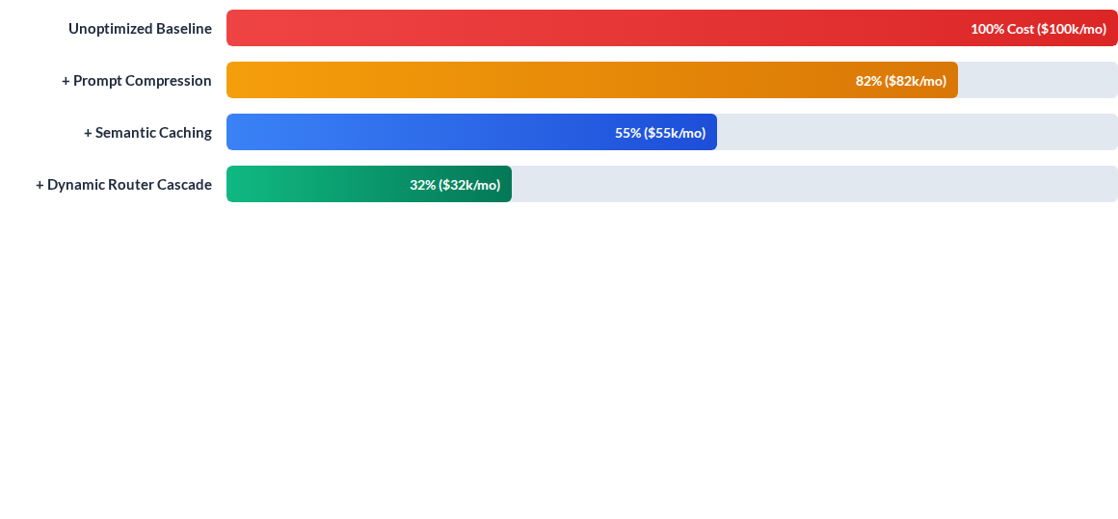
Impact of FinOps Optimization Strategies
Applying prompt compression, L1/L2 semantic caching, and dynamic tier routing produces a cumulative 68% cost reduction without compromising decision quality.

Slide 16

ROI Assessment & Financial ROI Model
Quantifiable ROI Value Pillars
Cycle Time Reduction: Processing time dropped from 48 hours to 4 minutes per claim.
312%
Operational Cost Shift: Cost per claim reduced from $18.50 (manual) to $2.10 (Agent + HITL).
Projected 3-Year Enterprise ROI
Based on 1.2M Annual Transactions in Automated Claims Processing
Capacity Multiplier: Architect teams scale operations by 8x without linear headcount increase.

Slide 17
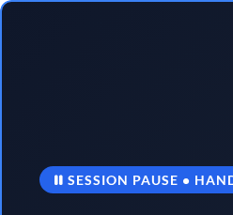
Lab Breakout: Token Profiling & Caching Implementation
Hands-on coding session: Implement token counting middleware, semantic caching with Redis, and model router fallback in code.
DURATION50 Minutes
TECH STACKPython / Java / .NET + Redis / LiteLLM
ARTIFACTCost-Optimized Model Router Code

Slide 18
PART 4 • CAPSTONE PROJECT SYNTHESIS
Capstone Checkpoint 4: Cost, Latency & Governance Matrix
Finalizing team capstone specifications with FinOps models, zero-trust security perimeters, and NFR targets

Slide 19
Capstone Checkpoint 4 Deliverables
Required Blueprint Additions
Jury Presentation Checklist (Day 5)
Security & Guardrail Spec: Map OWASP threat mitigations and zero-trust sandbox boundaries for capstone tools.
Topology Architecture Diagram (Day 1)
MCP & HITL Decision Boundaries (Day 2)
FinOps Financial Model: 3-year TCO calculation and estimated token cost per transaction for your scenario.
Cloud Deployment & CI/CD/CT Pipeline (Day 3)
NFR Tradeoff Matrix: Define latency targets (TTFT), model tier routing rules, and semantic cache policies.
FinOps, Security & TCO Tradeoff Blueprint (Day 4)

Slide 20

Questions & Discussion
Day 4 Wrap-Up • Next Session: Day 5 - Domain-Driven Design & Capstone Jury Defense

Slide 21


Image Sources
https://hidekazu-konishi.com/images/ai_agent_defense_in_depth_model_001.png
Source: hidekazu-konishi.com
https://cdn.sanity.io/images/sy1jschh/production/ad2e9a04f92158f9f2ab372b363832f6c47de73e-1382x1056.png?w=3840&q=80&fit=clip&auto=format
Source: redis.io

